Slide 1
ADHD, Executive Functioning and GT:
How to Drive a Race Car When the Steering Wheel Doesn't Work
Kristin Kassaw, MD

Slide 3
Executive Functioning
Executive Functions
(Both active and inhibitory roles in behavior)
Independently initiate behaviors
Select relevant tasks and goals
Hold information actively to manipulate and utilize
Inhibit impulses
Regulate emotions, monitor and evaluate behavior
Think flexibly in changing circumstances, plan to solve problems
Executive functions consist of interrelated control prosses regulating goal directed behavior including
selection
initiation
organization
execution and monitoring
Executive functioning primarily occurs in the prefrontal cortex

Slide 4
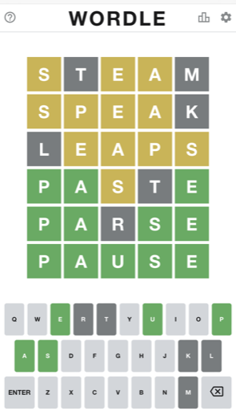
Examples of Executive Function In Daily Life
Planning a project
Inhibiting emotional responses in social settings
Setting goals
Delayed gratification
Responding to feedback
Adjusting strategies in problem solving

Slide 5
The Marshmallow Test
Study on delayed gratification led by psychologist Walter Mischel in 1972.
Children were offered a choice between one marshmallow now or marshmallows if they could wait while the researcher left the room for about 15 minutes.
Children were followed for years and those who waited showed greater educational attainment and better outcomes in other domains of functioning.
More contemporary studies have shown improvement in the test with increasing preschool attendance
Further analysis of test performance suggests affluence is significant factor (impact of scarcity)
Implied ability to delay gratification is static but can be influenced by surroundings
This Photo by Unknown Author is licensed under CC BY-SA-NC

Slide 6
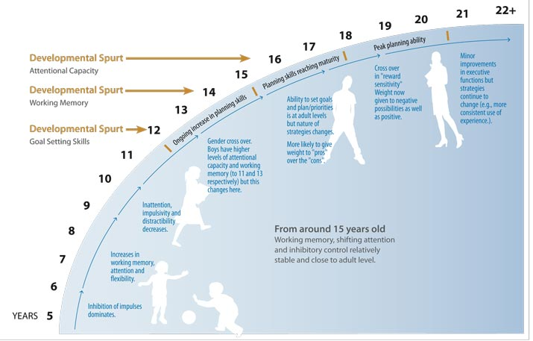
Executive Function from Childhood to Adulthood

Slide 7
ADHD and Executive Function – What’s the link?
The disorder most associated with executive function deficits is Attention Deficit Hyperactivity Disorder (ADHD)
ADHD is a neurodevelopmental disorder, which may persist across the lifespan
ADHD is characterized not only by problems with regulation of attention but also working memory, processing speed and executive functioning
Difficulties with organization, planning time management, emotional regulation, self monitoring, and impulse control are prominent
Children with ADHD are delayed 2-3 years in development of skills like executive functioning
This Photo by Unknown Author is licensed under CC BY-SA-NC

Slide 8
ADHD and Gifted Children
Gifted children can have asynchronous development compared to peers.
Some gifted children have well developed executive functioning compared to peers.
GT students with ADHD have a significant gap between intellectual ability and executive function (2 years ahead in math, 2 years behind in executive functioning)
Executive function deficits can be mischaracterized as willful
May take a toll psychologically – shame, anxiety, low self esteem, helplessness

Slide 9
Elementary Age Children
Disorganization
Losing things
Frustration with tasks requiring sustained effort
Avoiding complicated tasks
Problems in peer relationships
Inflexibility in problem solving
Feeling overwhelmed and anxious
This Photo by Unknown Author is licensed under CC BY-NC-ND

Slide 10
Middle and High School Years
Unable to plan and break down a project into components
Avoids complex projects due to feeling overwhelmed
Unable to prioritize
Unable to reflect on work quality
Struggles with changing course on a project after feedback
Difficulty with emotional regulation
Difficulty in peer communication, struggles to monitor behavior
Struggles with or avoids tasks such as driving
Unable to shift attention from phone, laptop, video games
This Photo by Unknown Author is licensed under CC BY-NC-ND

Slide 11
Executive Function and Parenting
A child with executive function difficulties is a challenge for parents
Parents may also have problems
Parents who had good EF at the same age
Hard to be a child’s frontal lobe
Tendency to compare to successful peers
Family sacrifices due to poor time management
Emotional regulation
Knowing when to support and when to allow failure
Social isolation

Slide 12
What can be done at home?
Everyone takes a deep breath. Repeat as often as necessary.
Help create structure (scaffolding)
Get a good planner (www.orderoutofchaos.com)
Create space for work (quiet but supervised) with no devices
Model daily to do lists
Check Schoology daily
Help with planning a big project
Check in often on work progress
Encourage short breaks with a timer
Know when to go to bed
Focus on improvement over time
This Photo by Unknown Author is licensed under CC BY-SA

Slide 13
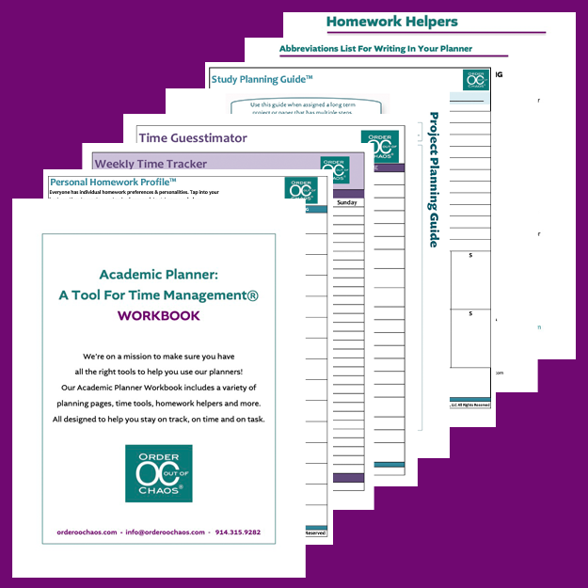
What can be done at school?
Let teachers know your child’s needs (a letter at the start of the year, emails)
Start the process for obtaining accommodations or modifications
504 plan
IEP
Help create a plan for structure at school
How a child will use an organizer
Help build a strategies and routines (e.g., math problems with many steps) – Do it the same way every time.

Slide 14
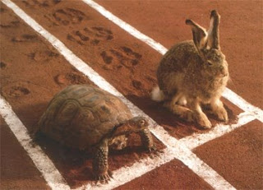
More Suggestions for Parents
Attend to self esteem and the tendency to compare
Tendency of gifted children to struggle with perfectionism and anxiety
Tendency to compare self negatively to highly organized peers
Normalize the strategies your child is using – “You wear glasses so you can see, right?”
Allow space for disappointment
It’s about progress
Get outside help
Educational evaluation
Executive functioning coach
Tutors
This Photo by Unknown Author is licensed under CC BY

